Slide 1
Shyamaghat Rainwater Model Project
RUCHI

Slide 2
12 families with a population of 65 people. . All families belong to schedule caste. . small land holding, an average of one acre. . they usually only have water during the monsoon season. . no regular water supply within the village. Only one hand pump on main road for drinking water supply. . Only 3 families owned toilets. The village is typical of the smaller villages in the hills of Himachal Pradesh. This particular village was chosen as it was of a size that made it suitable to be a "model" Rainwater Harvesting Village".
An overview

Slide 3
1. Ensure clean drinking water through household guttering, household rainwater collection tanks and community spring protection. 2. Improve the environmental sanitation of the village by the construction of latrines, wash rooms, compost bins, kitchen gardens and an incinerator. 2. To improve community health and wellbeing through education and primary health care.
OBJECTIVES

Slide 4
Proposed Activities
Construct rainwater tanks for each of the houses.
Install guttering and downpipes to each building in
the village.
Concrete the ground adjacent to the houses to falls
including the provision of rock wall terracing.
Construct two rainwater irrigation tanks.
Construct two recharge tanks.
Provide composting bins.
Educate the village community in primary health care,
organic farming, environmental sanitation, personal
hygiene and soil and water conservation practices.
Encourage immunization of children and pregnant
women.

Slide 5
Works done
9 ferro-cement tanks to collect roof top water
concretisation of 1030 M² open space (flooring) around the houses
285 Meter support wall
2 irrigation tanks
2 earthen tanks
9 composting units
Channel for water transport and silt trap chambers(3)
9 Sanitary latrines with washrooms with glazed tiles
One incinerator

Slide 6
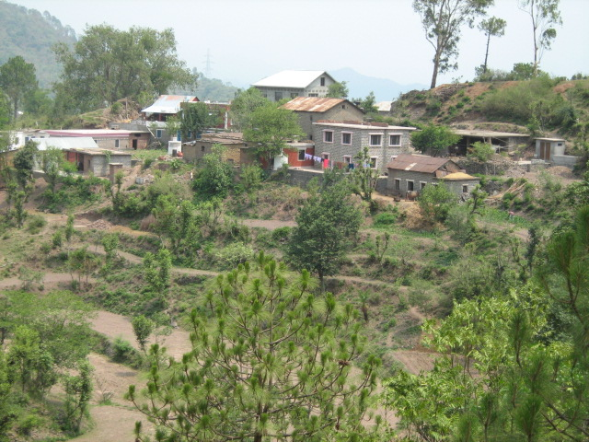
An overview

Slide 7
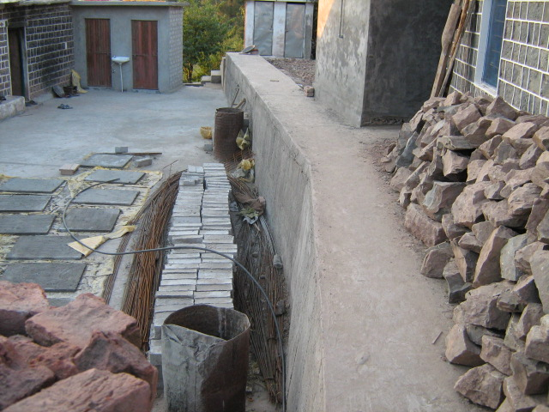
Retaining wall
Then
Now

Slide 8
Cementing floor
Then
Now

Slide 9
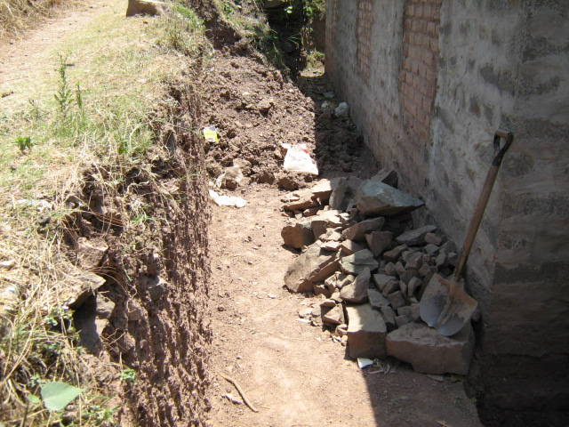
Retaining wall & flooring
Then
Now

Slide 10
Floor concreting
Then
Now

Slide 11
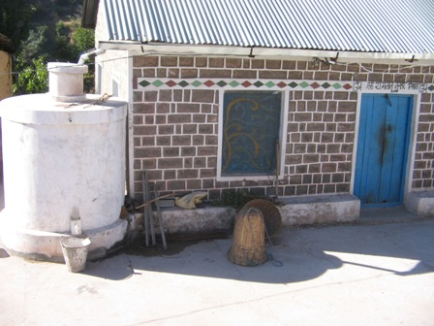
Ferro-cement water storage tanks
Now

Slide 12
FCT – filter preparation
Now
Now

Slide 13
Silt traps
Now
Now

Slide 14
Sanitary toilet & bath room
Now
Now

Slide 15
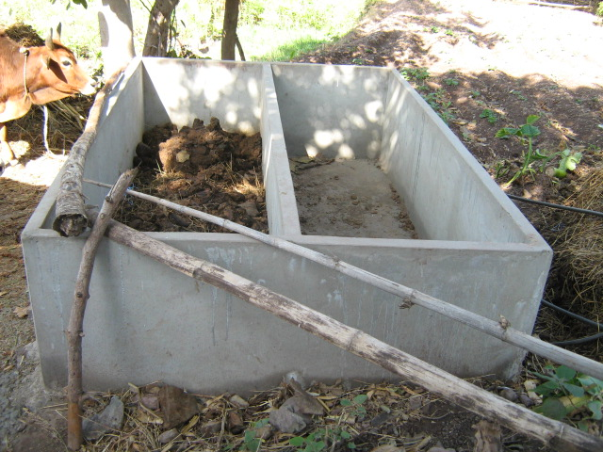
Organic Composting
Now
Now

Slide 16
Path development
Then
Now

Slide 17
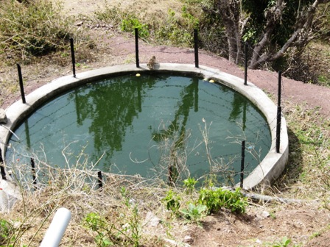
Irrigation Tank - 1
Then
Now

Slide 18
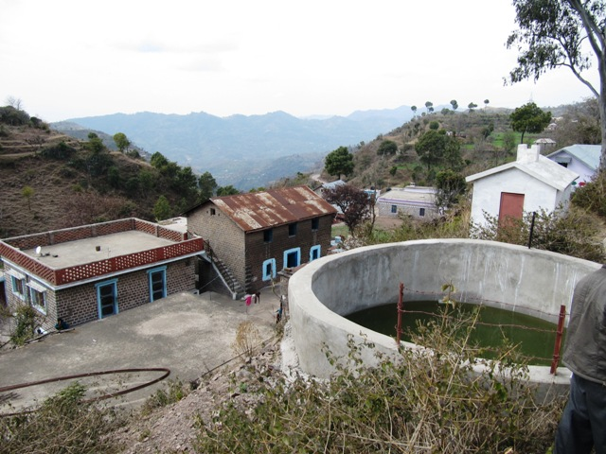
Irrigation Tank - 2
Then
Now

Slide 19
Earthen Recharge Tank - 1
Under development
Now

Slide 20
Earthen Recharge Tank - 2
Then
Now

Slide 21
Village Incinerator
Then
Under development

Slide 22
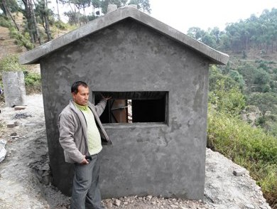
Village Incinerator
Now – Front View
Now – Rear View

Slide 23
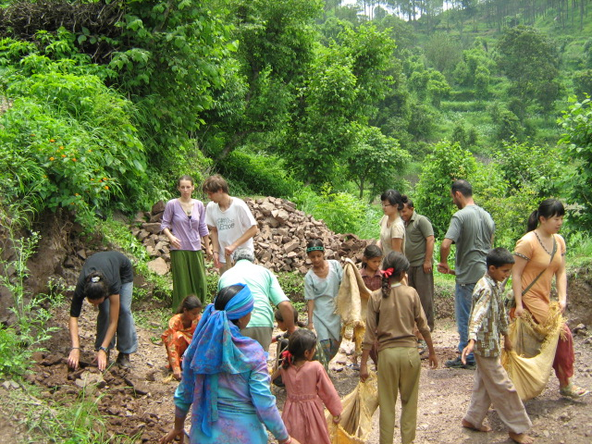
Community Participation & intercultural learning

Slide 24
Capacity Building
SHG
Campaigning

Slide 25
Pollutant Hot-mix Plant
Then
Now

Slide 26
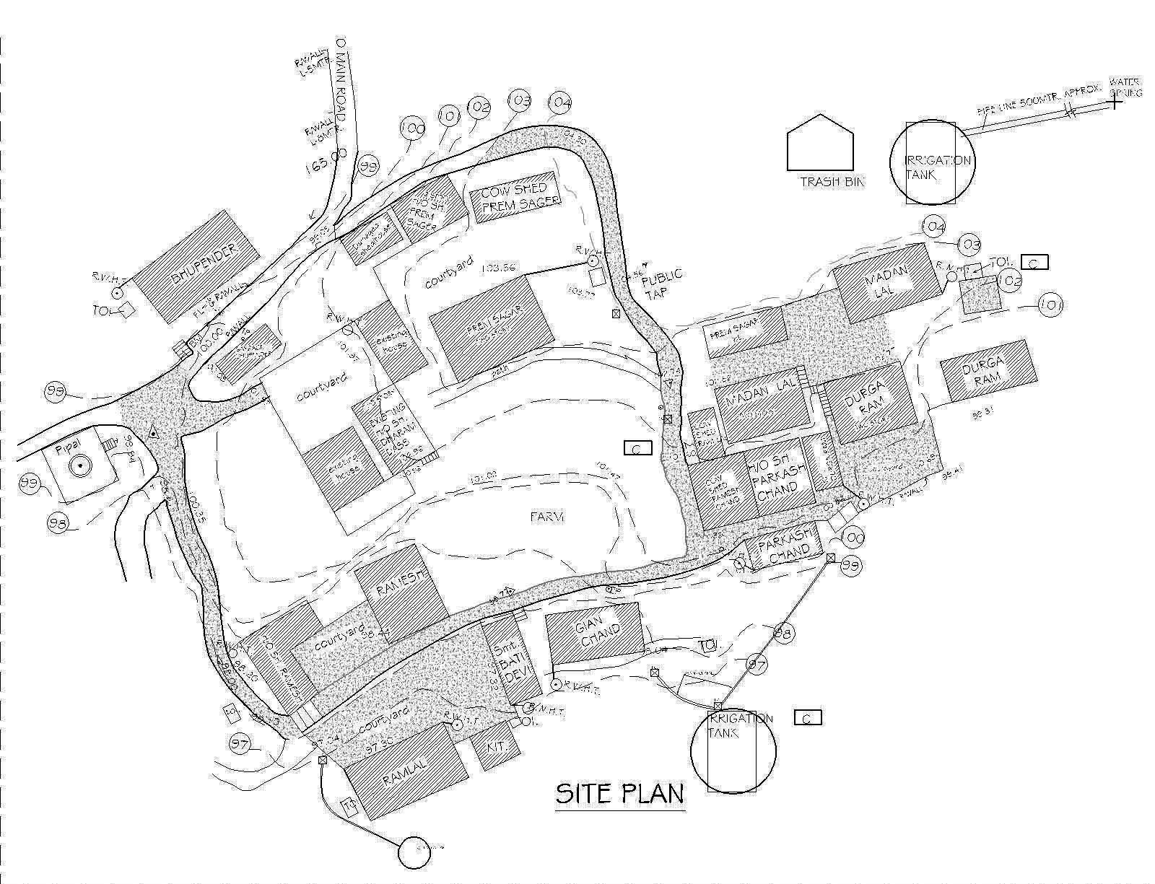
Works done
WwworkWOs done

Slide 27
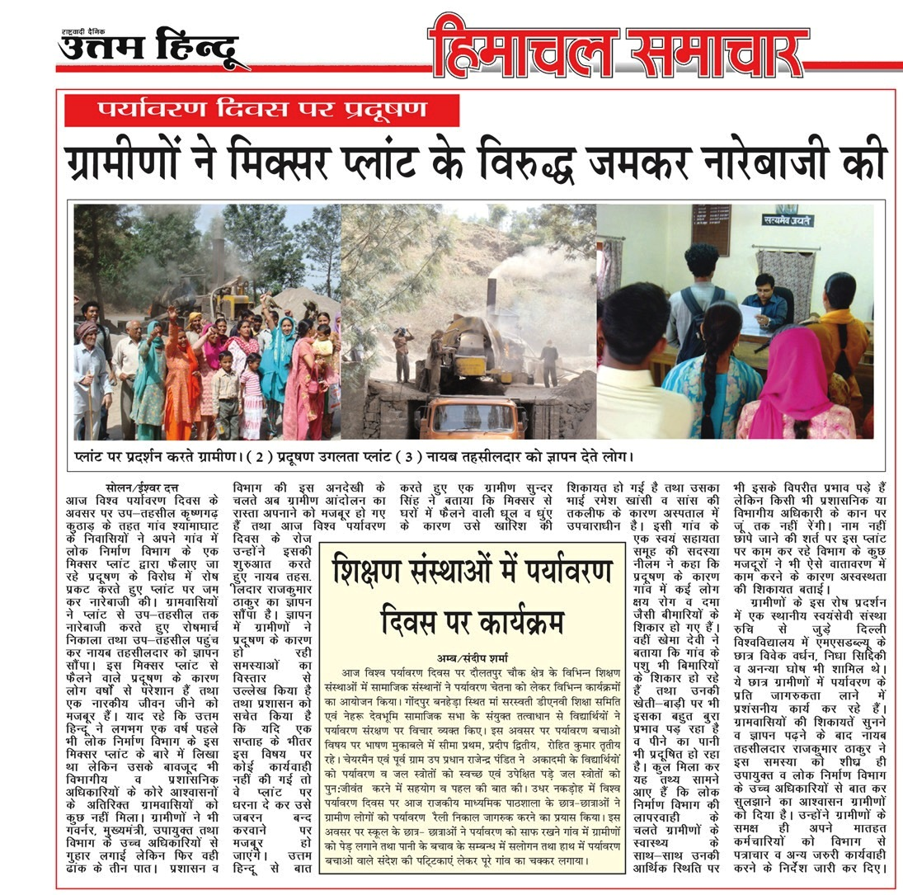

Slide 28
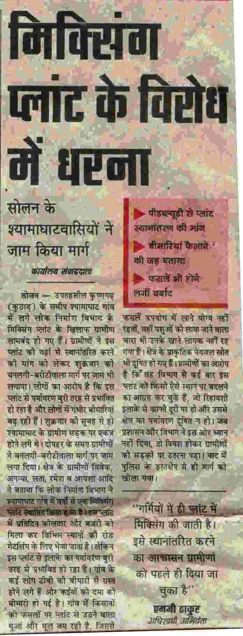
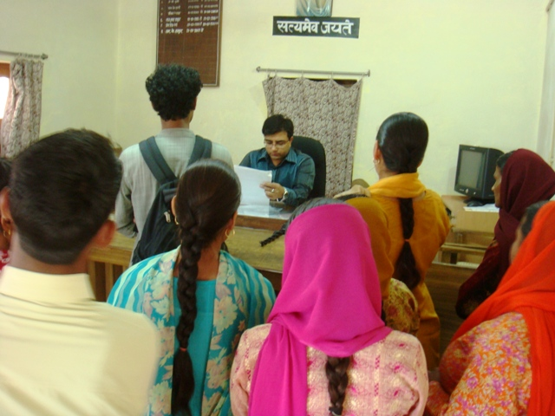
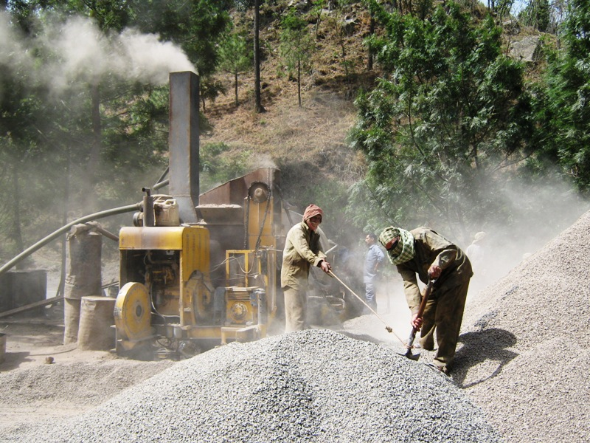

Slide 29
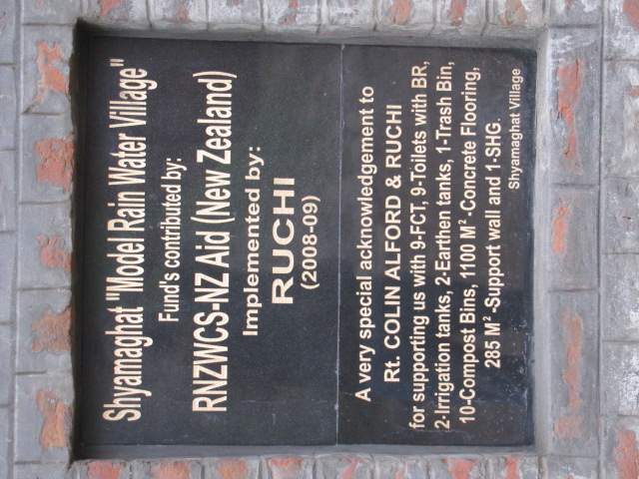

Slide 30
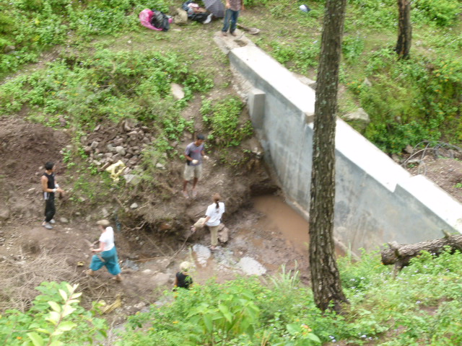
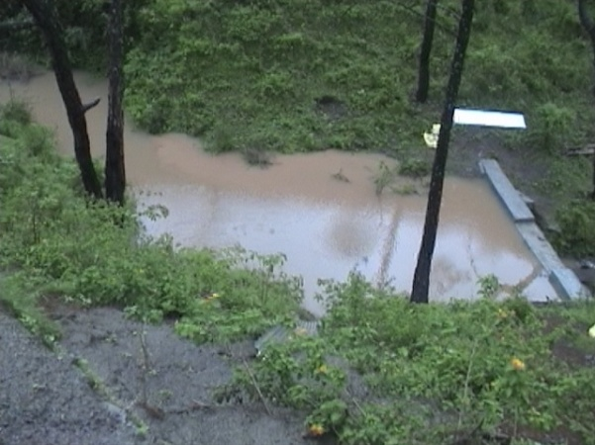
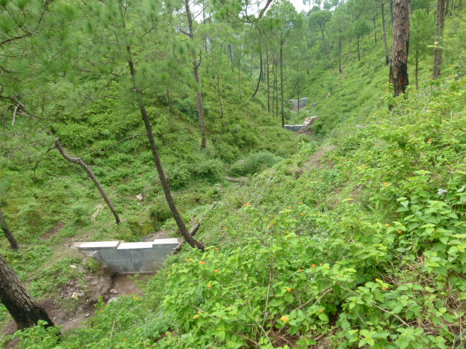
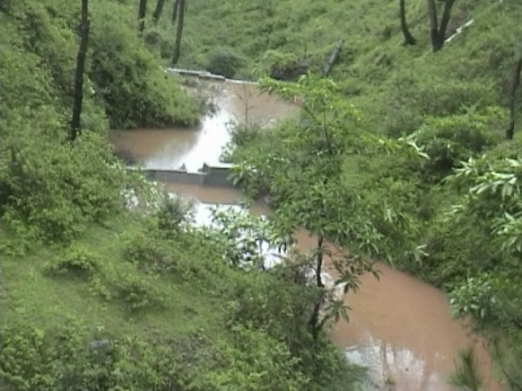
Additional work – a series of check dams

Slide 31
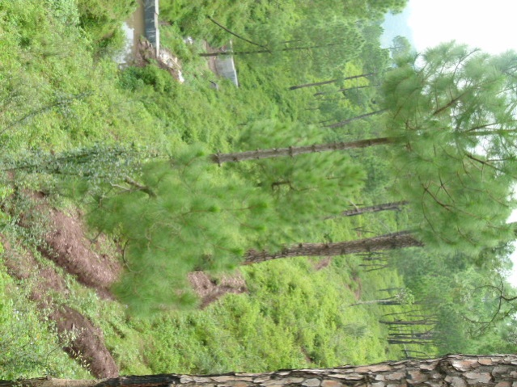
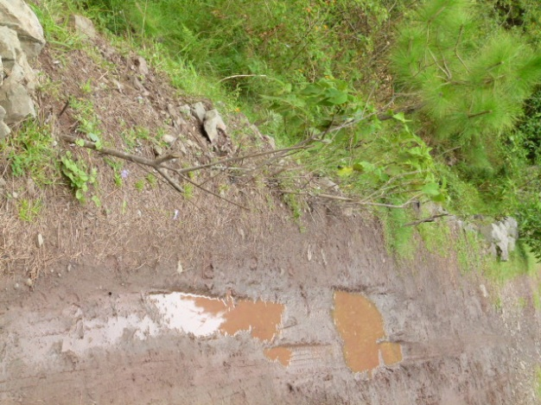
Road side plantation and trenching

Slide 32
Would you like to be a part of this noble cause?
How would you like to help
?

Slide 33
Thank You

