Slide 1
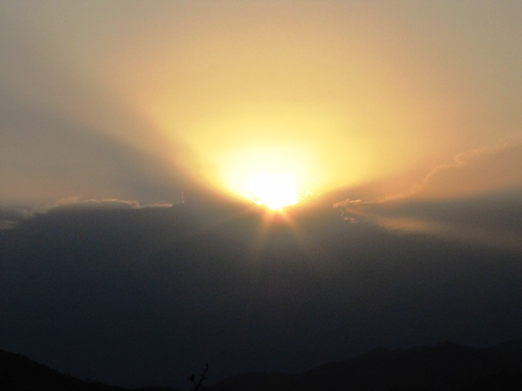
Bhogpur Model Project

Slide 2
An Overview of village
23 families
No regular source of drinking water
All families belong to scheduled castes
No source of irrigation
Farm land average 1 acre
No toilet and wash rooms in the village
Men work as casual labourers

Slide 3
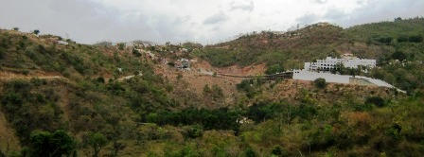
Bhogpur village above Haripur Gurudwara

Slide 4
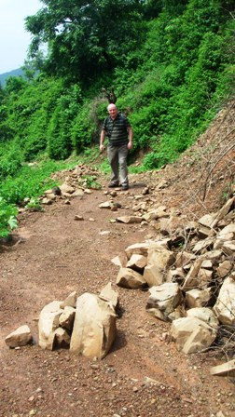
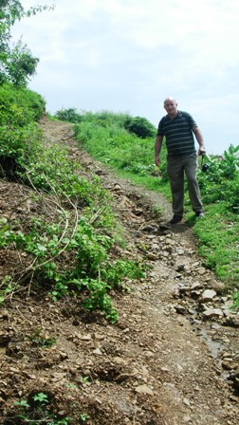
Access to village during monsoon

Slide 5
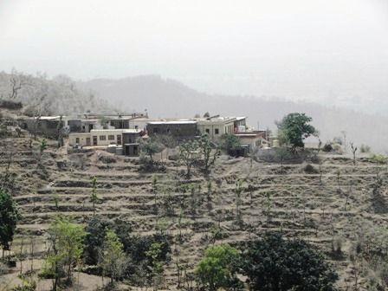
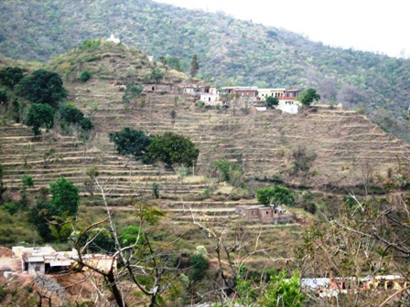
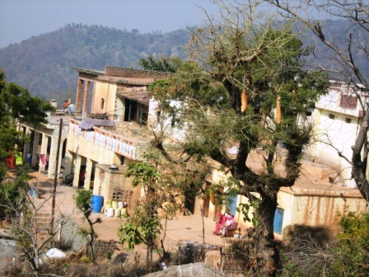
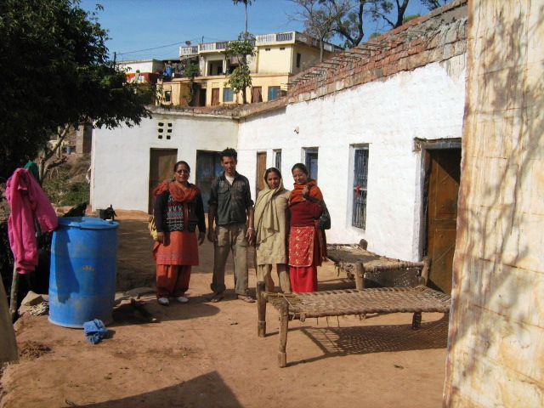
The village

Slide 6
OBJECTIVE 1 To improve community health and well being of the residents of Bhogpur and Dora Villages through health education and provision of clean drinking water:
Activities :
Engage with the village to establish a Project Advisory Committee
and Self Help Group.
Educate and empower the village community in primary health care,
personal hygiene, environmental sanitation, climate change and soil
and water conservation practices.
Introduce new agricultural practices for enhancing farm production.
Engage a surveyor to ensure the water is collected adequately.
Construct rainwater tanks for each of the houses (23 No.).
Install guttering and downpipes to each building in the village

Slide 7
OBJECTIVE 2 Ensure better quality of life through irrigation of 40% of cultivated land and livelihood activities:
Activities:
Train villagers in basic construction techniques.
Develop roof catchment to transport water to irrigation tanks.
Construct two rainwater irrigation tanks.
Construct three recharge ponds.
Construct Gully plugs on the stream to check water run off.
Trenching for moisture retention
Tree Plantation

Slide 8
OBJECTIVE 3 Improve the environmental sanitation of the village by the construction of latrines, wash rooms, compost bins and incinerators.
Activities:
Construct 23 latrines and wash/shower facilities
Construct 23 compost bins
Construct 3 community garbage collection bins
400 meter long and 4 feet wide link path from Haripur road head to Bhogpur village
Construct 20 animal feeding stalls with 20 families

Slide 9
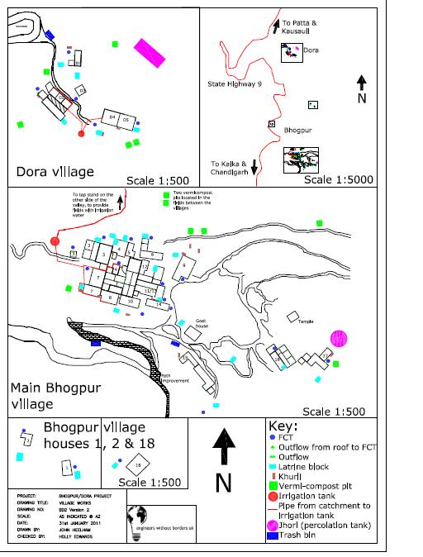
Completed works

Slide 10
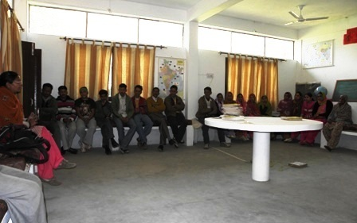
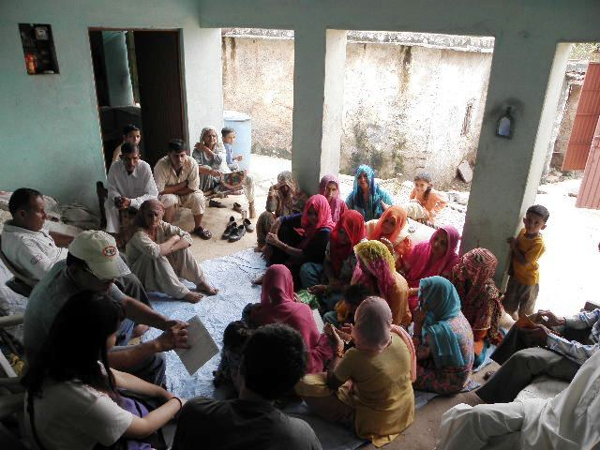
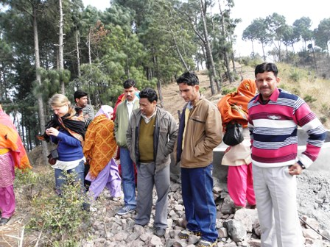
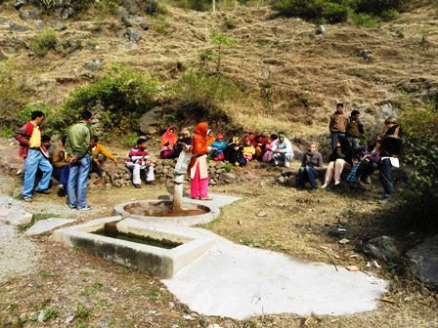
Empowering People – a beginning

Slide 11
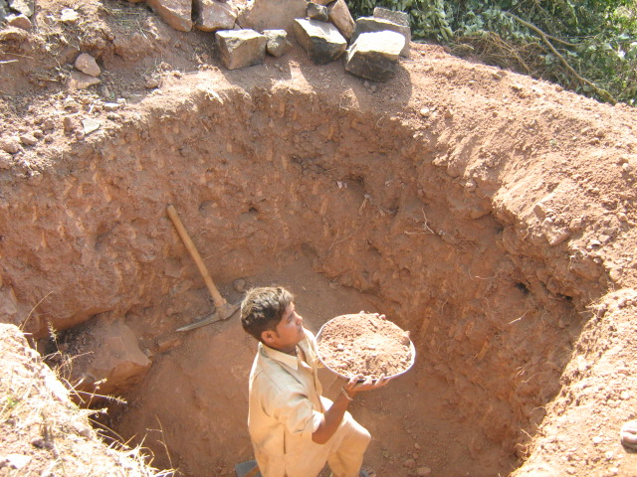
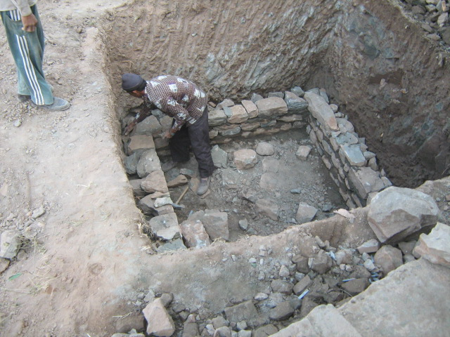
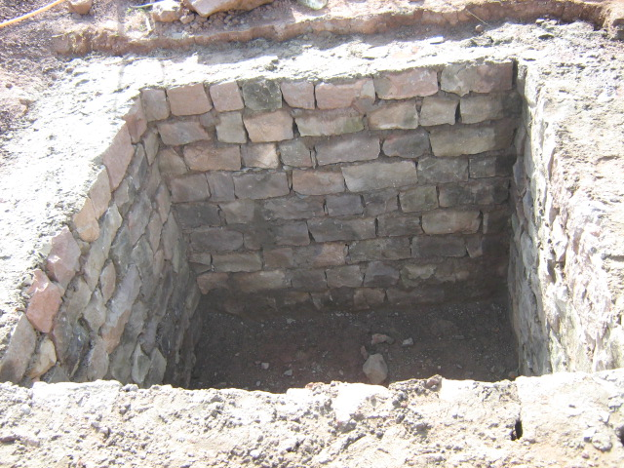
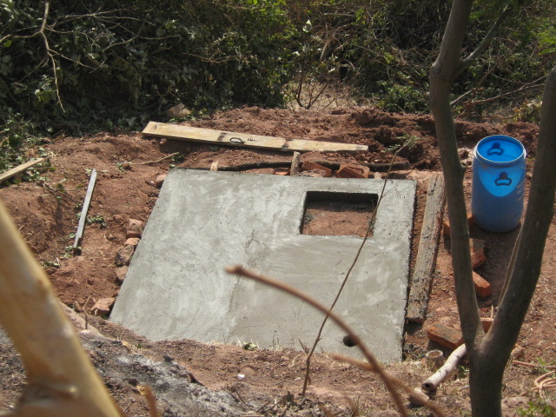
Construction of latrines

Slide 12
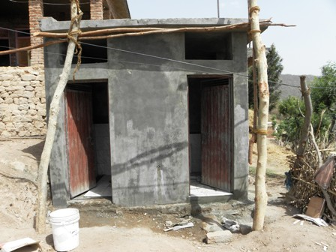
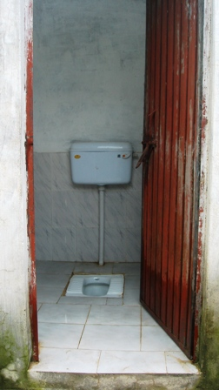
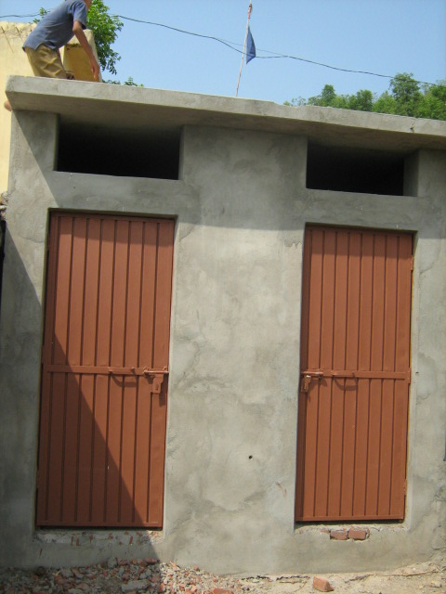
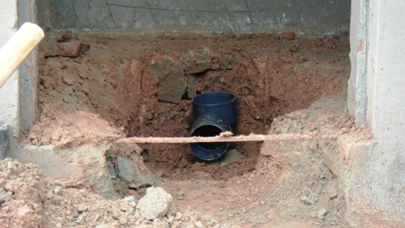

Slide 13
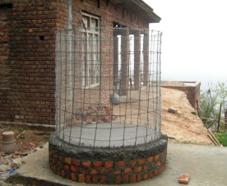
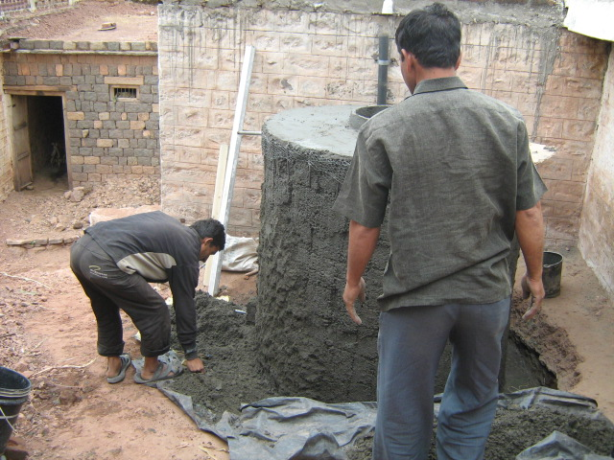
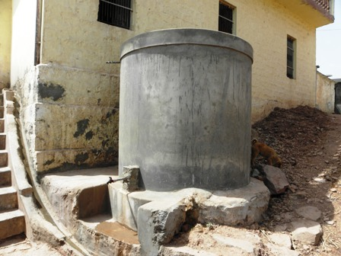
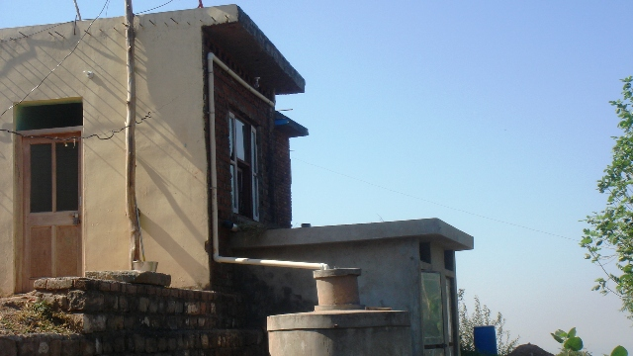
Making Ferro-cement Storage Tanks

Slide 14
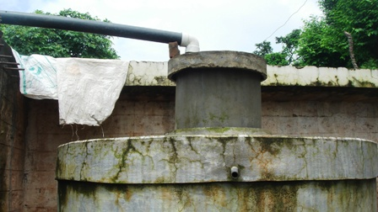
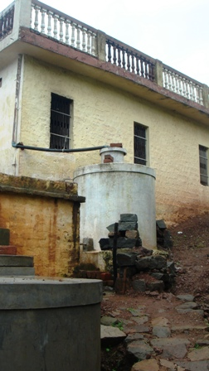
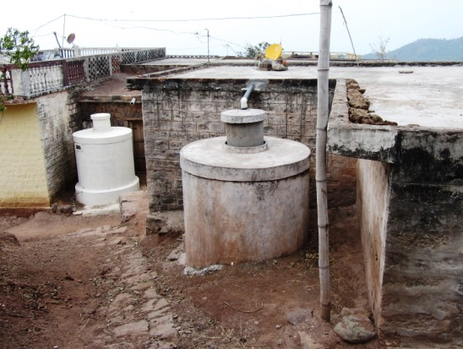
Ferro-cement water storage tanks

Slide 15
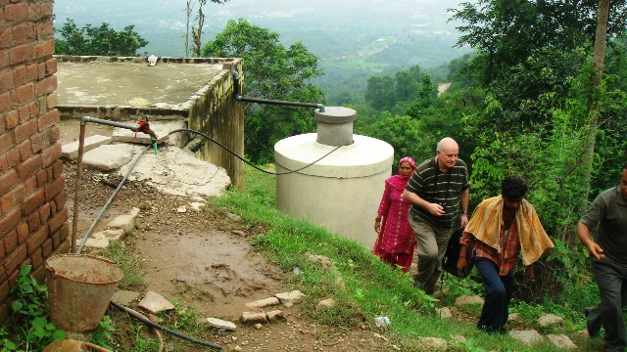
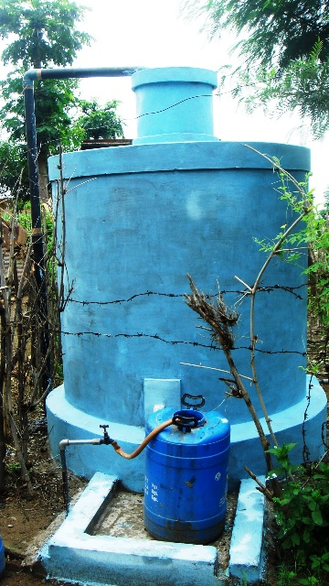
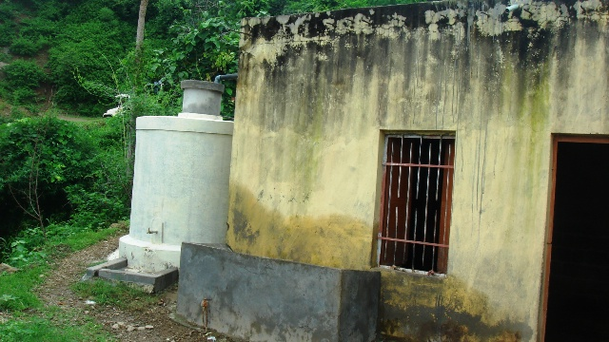
More storage tanks

Slide 16
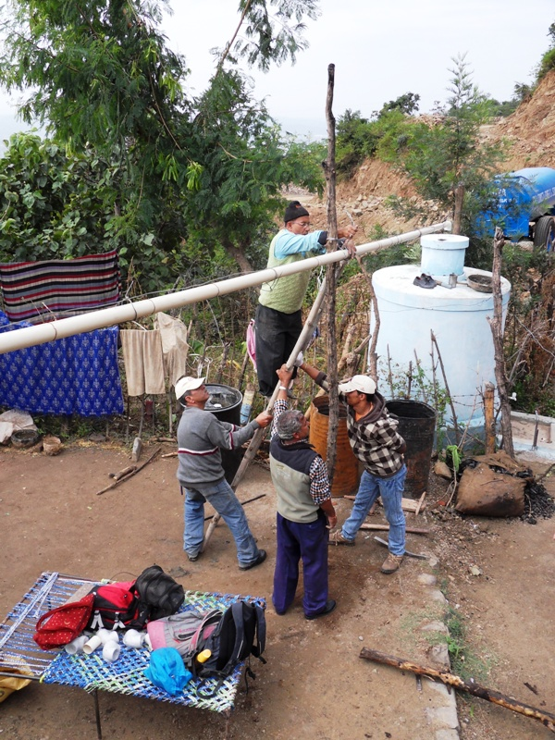
Fixing gutters

Slide 17
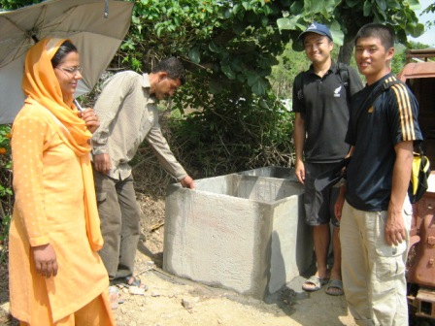
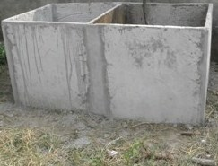
Trash bins

Slide 18
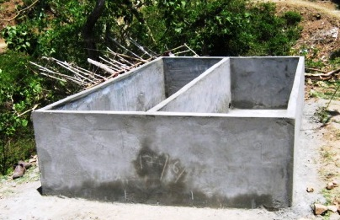
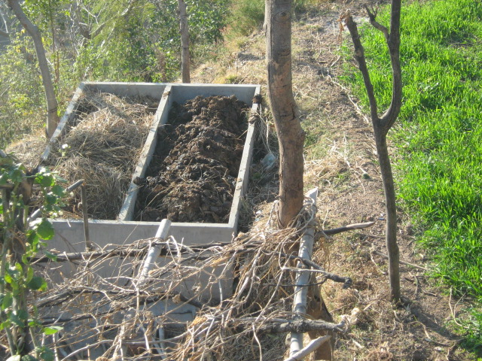
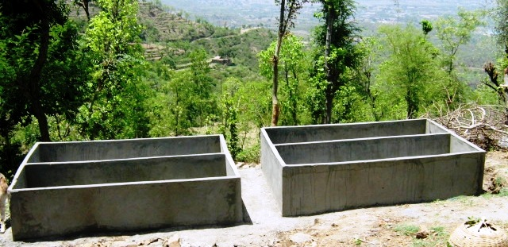
Composting bins for worms

Slide 19
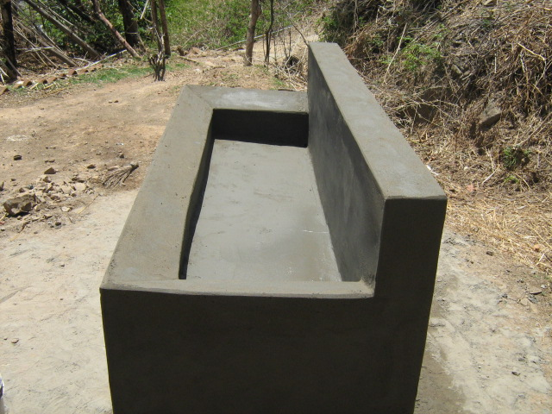
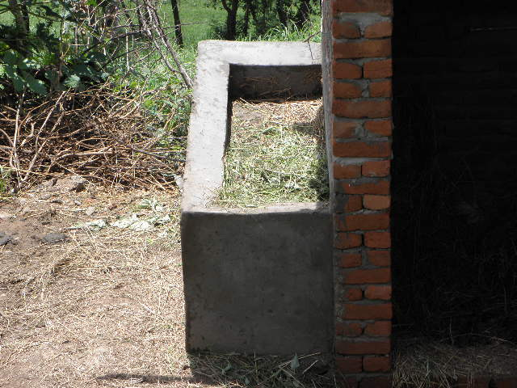
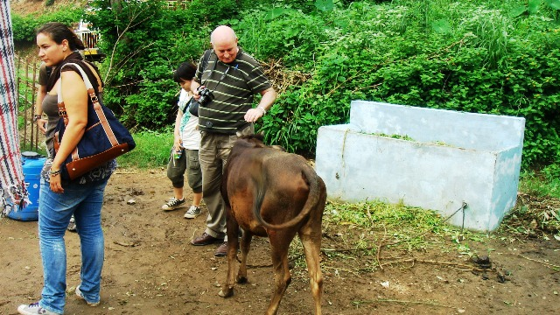
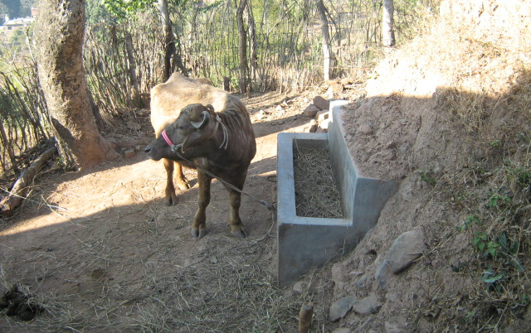
Animal Feeding Stalls

Slide 20
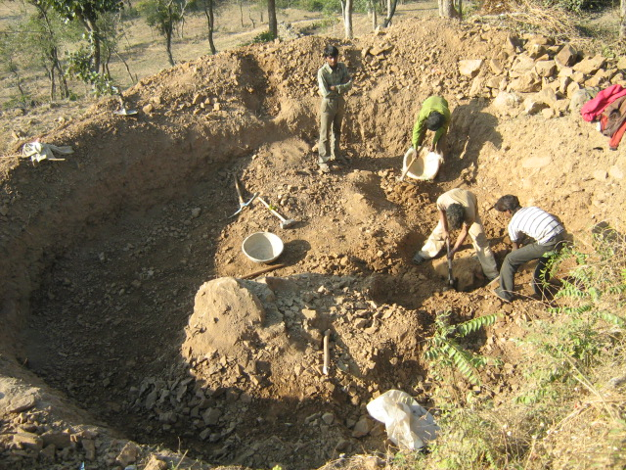
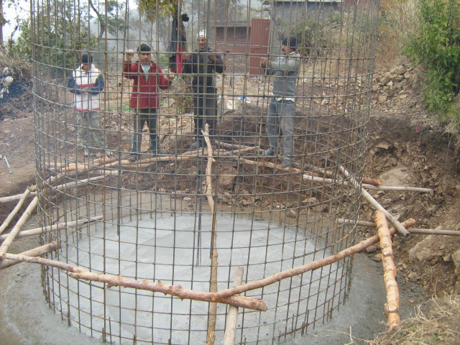
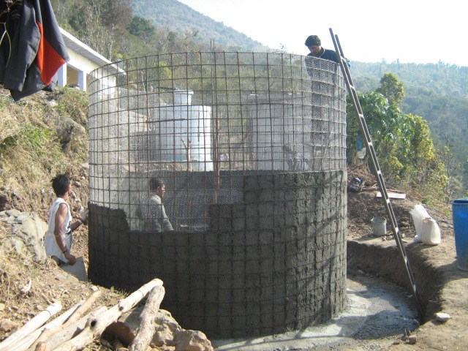
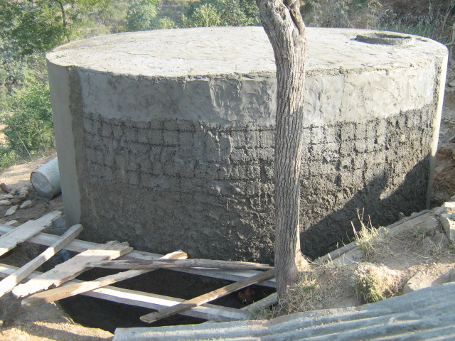
Irrigation Tank of ferro-cement

Slide 21
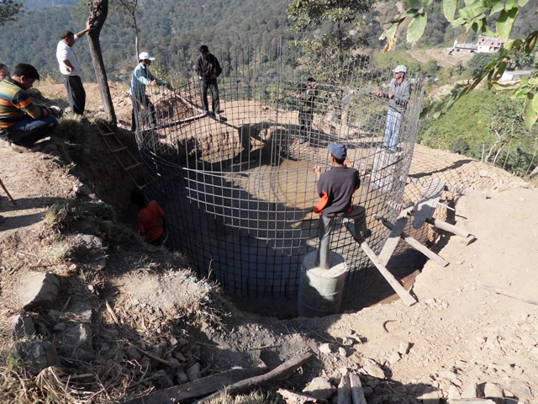

Slide 22
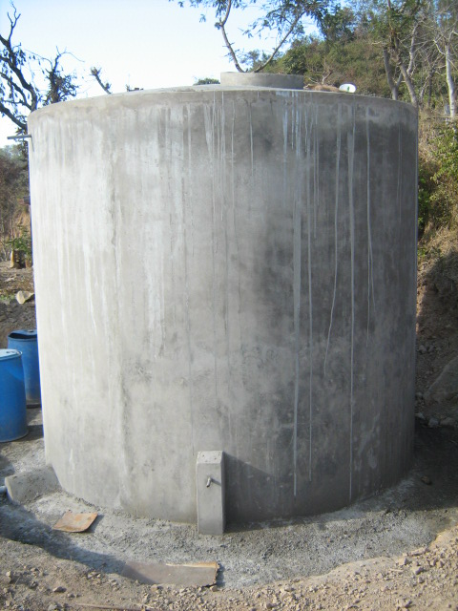
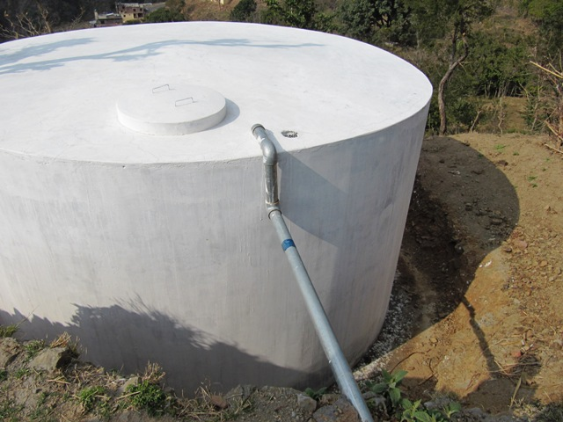
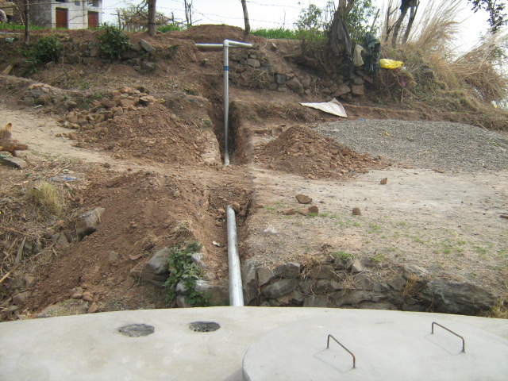
Completed Irrigation Tank

Slide 23
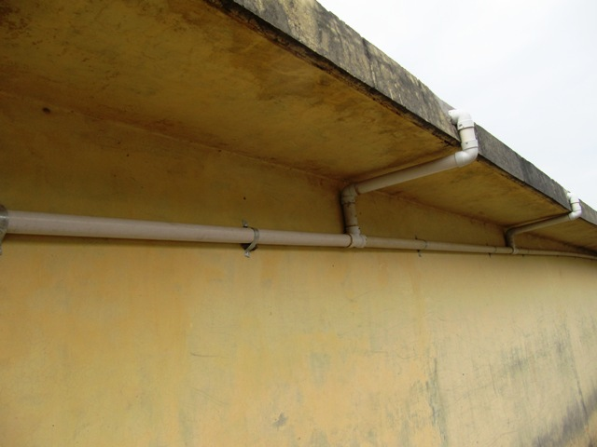
Developing Catchment for Irrigation Tank

Slide 24
Developing water Catchment

Slide 25
Earthen Recharge Pond

Slide 26
Earthen ponds (Johris)

Slide 27
Plantation and trenching

Slide 28
Plugging Gullies

Slide 29
Making a Link Path

Slide 30
Educational visit to the village

Slide 32
Happy times on completion of works

Slide 33
Additional works in Dora village: Protection wall to access village

Slide 34
Access to village.......

Slide 35
Cementing Path in Dora village

Slide 36
Let us join hands to work together
Thank You !!

