Slide 1
Rainwater Harvesting and Community Development Project in Bag village
1st March 2011 to 31st March 2012

Slide 2
Goal
To raise the standard of living, improve the environmental health and empower the communities through people centred development. In the long run this will improve the "quality of life" of the villagers of Bagh-Pathia.

Slide 3
Intended Outcome
The community health and well being of the residents of Bagh and Pathia Villages will have improved as evidenced by a reduced Increased groundwater recharge
Farm production (sustainable economic development). The target is to bring a further 10% of the cultivated land under irrigation (Approximately an additional hectare of land will become productive.) In addition cash crops will be introduced.
Environmental sanitation in the village has improved through the construction of latrines, wash rooms, compost bins and incinerators.

Slide 4
An Overview of village
18 families
No regular source of drinking water
All families belong to lower castes
No source of irrigation
Farm land average 1 acre
No toilet and wash rooms in the village
Men work as casual labourers
The village is typical of the smaller villages in the
hills of Himachal Pradesh.
This particular village was chosen as it was of a size that made it suitable to be a "model" Rainwater Harvesting Village".

Slide 5
Proposed works......
The project aimed to build
3 irrigation tanks,
3 percolations tanks,
14 ferro-cement water storage tanks,
12 sanitary toilets with wash rooms,
2 washrooms,
10 each composting units and animal feeding units,
110 metres of water transport channels,
4 water chambers,
cementing of 500 sq.mt open space around houses to serve as water catchment and
paying of 200 meters of village path and associated works

Slide 6
Case Study - Bagh village
An Overview of village
18 families
No regular source of drinking water
All families belong to lower castes
No source of irrigation
Farm land average 1 acre
No toilet and wash rooms in the village
Men work as casual labourers
The village is typical of the smaller villages in the
hills of Himachal Pradesh.
This particular village was chosen as it was of a size that made it suitable to be a "model" Rainwater Harvesting Village".

Slide 7
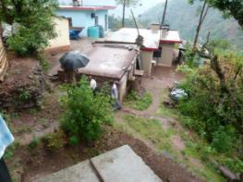
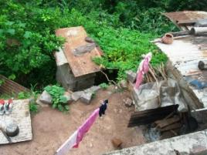
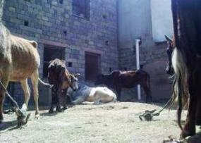
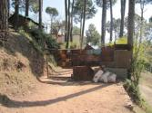
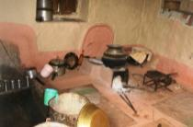
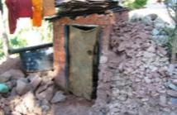
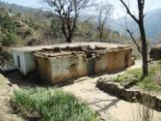
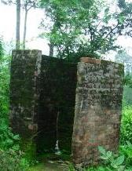
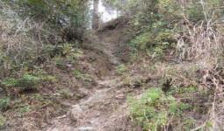
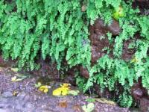
Overview… before the project….

Slide 8
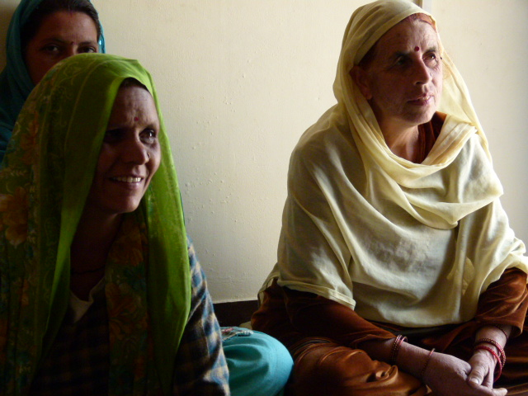
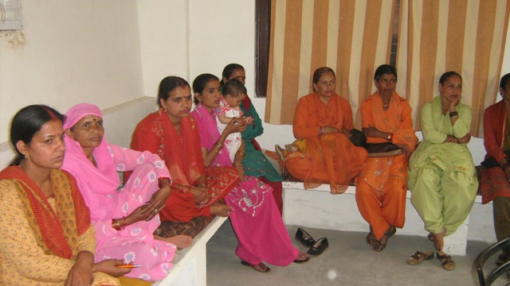
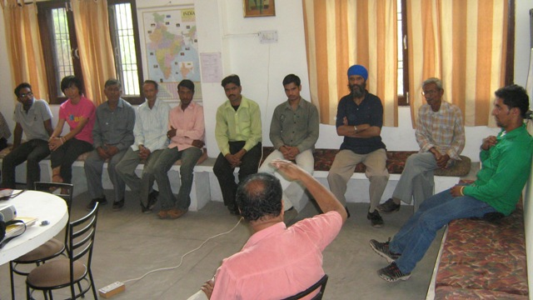
Planning & deciding priorities… followed by study visits to fully understand the implications of the project

Slide 9
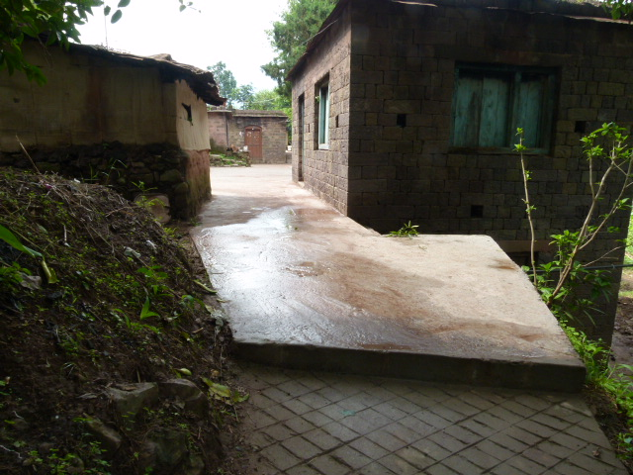
Work began with improvement in access to village

Slide 10
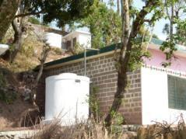
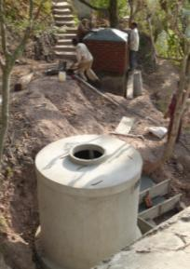
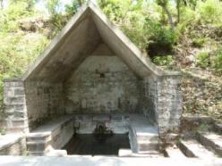
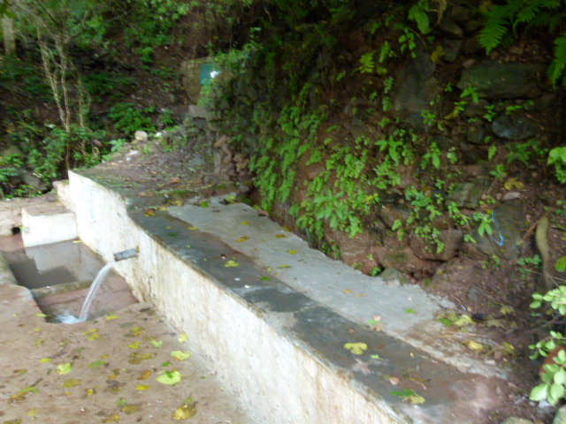
2nd priority - Improving access to Drinking water

Slide 11
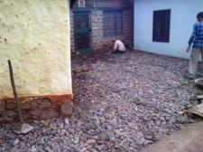
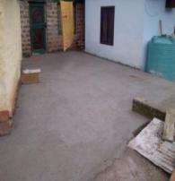
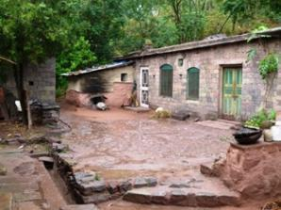
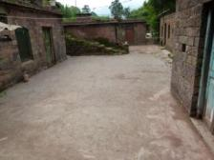
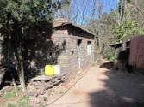
3rd priority - Developing Rainwater catchment and irrigation ..

Slide 12
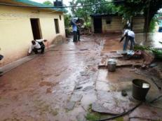
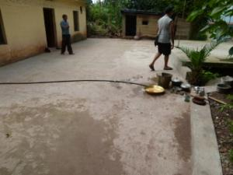
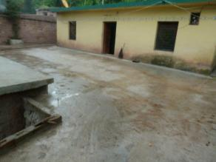
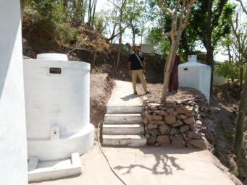
Water catchment development

Slide 13
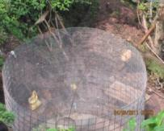
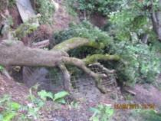
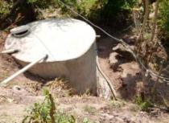
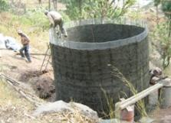
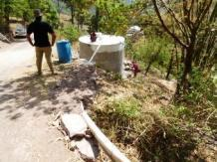
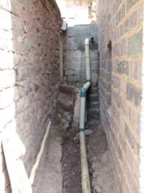
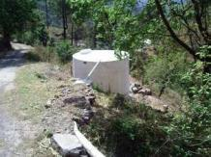
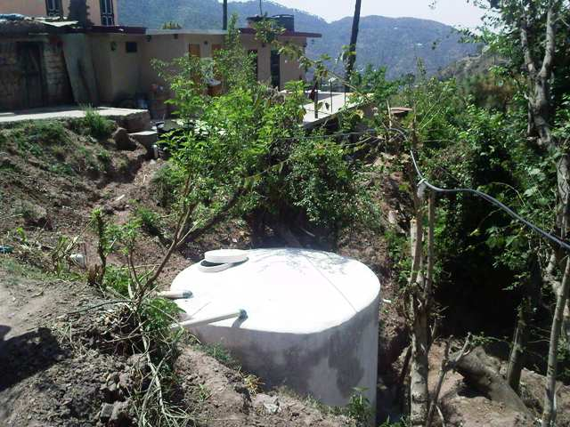
Irrigation tanks

Slide 14
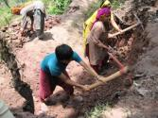
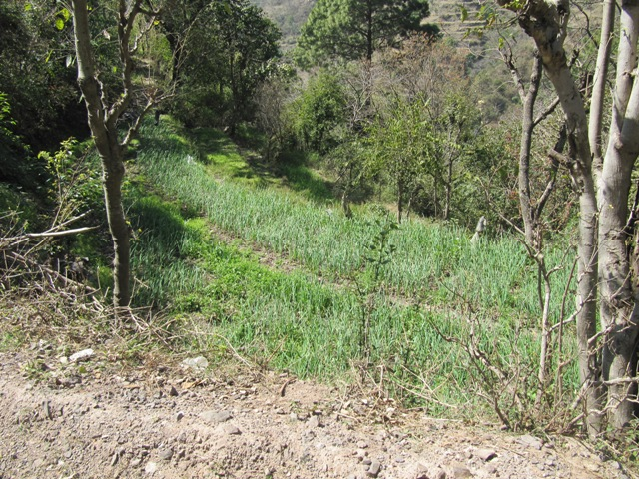
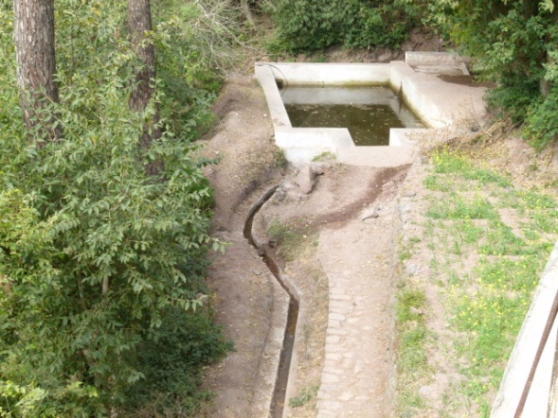
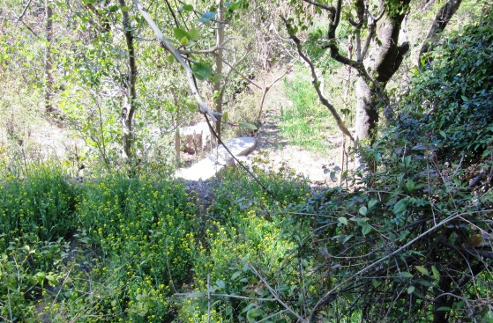
Irrigation source development…

Slide 15
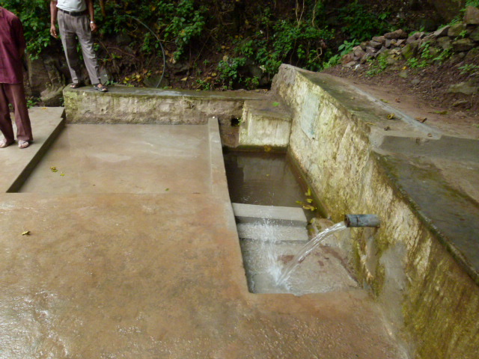
Protection of water and hygiene

Slide 16
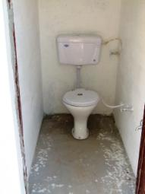
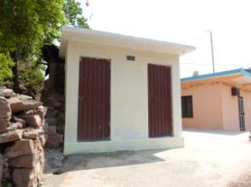
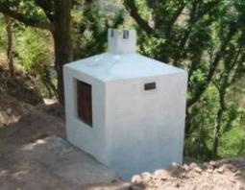
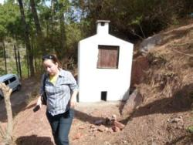
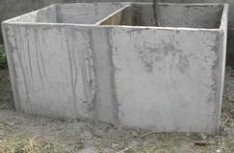
4th priority: Sanitation…. Toilets and trash bins

Slide 17
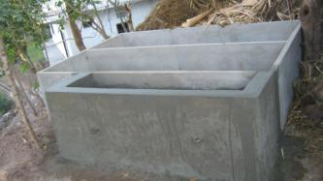
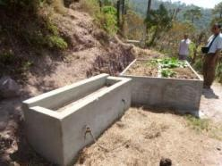
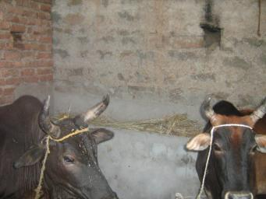
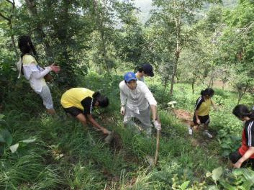
Introducing organic composting….

Slide 18
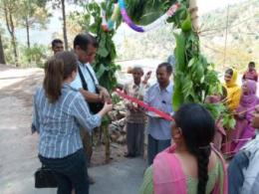
Moment of joy……

Slide 19
Would you like to be involved...
Your small contribution
can make a difference
for the world’s most
under-privileged people.

Slide 20
THANK YOU

